Slide 1
Bitcoin Price Prediction
CAPSTONE PROJECT
Presented By:
Voleti Sai Anushree - Amrita Vishwa Vidhyapeetham - Computer Science and Engineering

Slide 2
OUTLINE
Problem Statement
Proposed System/Solution
System Development Approach
Algorithm & Deployment
Result
Conclusion
Future Scope
References

Slide 3
Problem Statement
Predicting the price of Bitcoin, a highly volatile and speculative asset, involves analyzing various factors such as market sentiment, investor behavior, macroeconomic trends, regulatory developments, technological advancements, and adoption rates. Utilizing techniques from statistical analysis, machine learning, and data science, researchers and analysts aim to forecast short-term and long-term price movements. However, due to the inherent unpredictability of the cryptocurrency market and the multitude of variables at play, accurately predicting Bitcoin's price remains a challenging endeavor fraught with uncertainty.

Slide 4
Proposed Solution
The proposed system aims to tackle the challenge of accurately predicting Bitcoin price movements to facilitate informed investment decisions. This involves harnessing data analytics and machine learning methodologies to forecast price fluctuations effectively. The solution will encompass the following components:
Data Collection:
Data Collection: Gather historical Bitcoin price data from reliable sources such as cryptocurrency exchanges or financial data providers. Include relevant features such as trading volume, market capitalization, volatility, and sentiment indicators.
Data Preprocessing:
Clean and preprocess the collected data to handle missing values, outliers, and inconsistencies.
Feature engineering to extract relevant features from the data that might impact Bitcoin's price, such as trading volume, volatility, moving averages, sentiment scores, and external market indicators.
Machine Learning Algorithm:
Implement a machine learning algorithm, such as a time-series forecasting model (e.g., ARIMA, SARIMA, or LSTM), to predict Bitcoins price based on historical patterns.
Consider ensemble methods like Gradient Boosting Regressors or Random Forests to capture complex relationships between features and Bitcoin price movements.
Deployment:
Create an intuitive user interface or application offering real-time Bitcoin price predictions for various timeframes and market conditions.
Deploy the solution on a robust and scalable platform, ensuring reliable server infrastructure to handle high traffic loads and minimize response times for users.
Evaluation:
Evaluate the model's performance using metrics like Mean Absolute Error (MAE), Root Mean Squared Error (RMSE), or other relevant indicators to measure prediction accuracy.
Continuously monitor and fine-tune the model based on feedback and ongoing assessment of its effectiveness in forecasting Bitcoin prices.
Result : Robust system leveraging data analytics and machine learning to accurately forecast Bitcoin price movements.

Slide 5
System Approach
The system development approach will employ a combination of technologies including Python programming language, libraries such as pandas, NumPy, and scikit-learn for data processing and machine learning, alongside frameworks like TensorFlow or PyTorch for deep learning models, and possibly cloud computing platforms for scalability and data storage.

Slide 6
Algorithm & Deployment
Algorithm Selection:
The Gradient Boosting Regression algorithm is chosen for Bitcoin price prediction due to its ability to capture complex nonlinear relationships in data.
It is suitable for forecasting the volatile and dynamic nature of cryptocurrency prices.
Data Input:
Input features include historical Bitcoin price data, trading volume, volatility measures, sentiment analysis scores from social media and news sources, macroeconomic indicators, and technical indicators such as RSI and MACD.
These features provide comprehensive information about the market dynamics and investor sentiment influencing Bitcoin prices.
Training Process:
Historical Bitcoin price data along with input features are used for training the algorithm.
The dataset is split into training and validation sets, with cross-validation techniques applied to optimize hyperparameters and prevent overfitting.
Feature selection methods may be employed to identify the most relevant input features for the model.
Prediction Process:
Trained algorithm utilizes selected input features to make predictions for future Bitcoin prices.
Real-time data inputs including updated trading volumes, sentiment analysis scores, and macroeconomic indicators are considered during the prediction phase to refine forecasts and adapt to market changes.
The algorithm's output provides insights into potential price movements, assisting investors in making informed decisions.

Slide 7
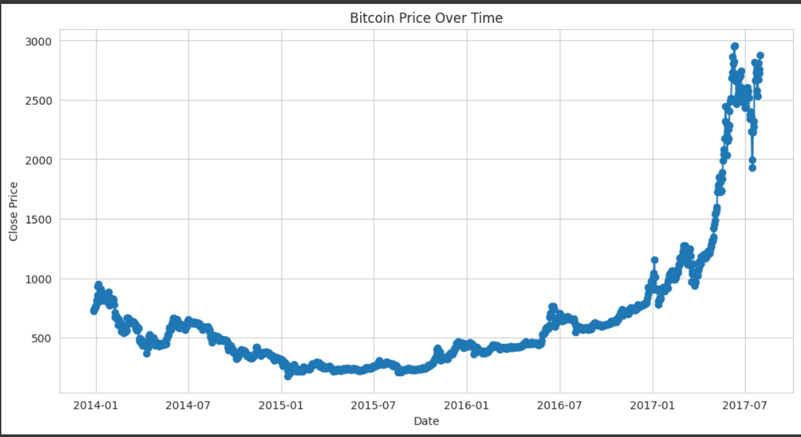
Result
Bitcoin Price Over Time

Slide 8
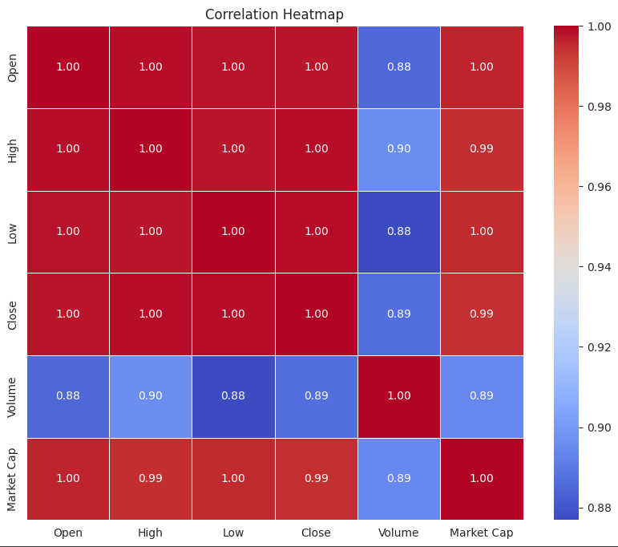
Result
Correlation Heatmap for attributes

Slide 9
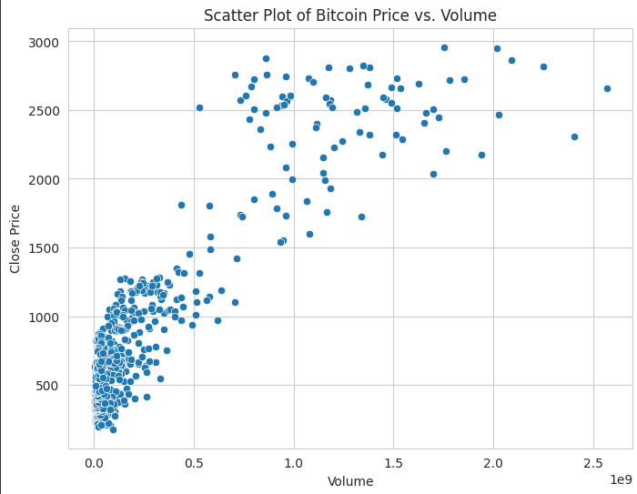
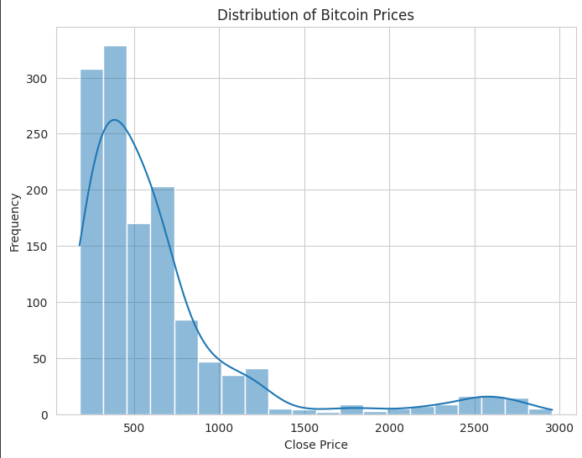
Result

Slide 10
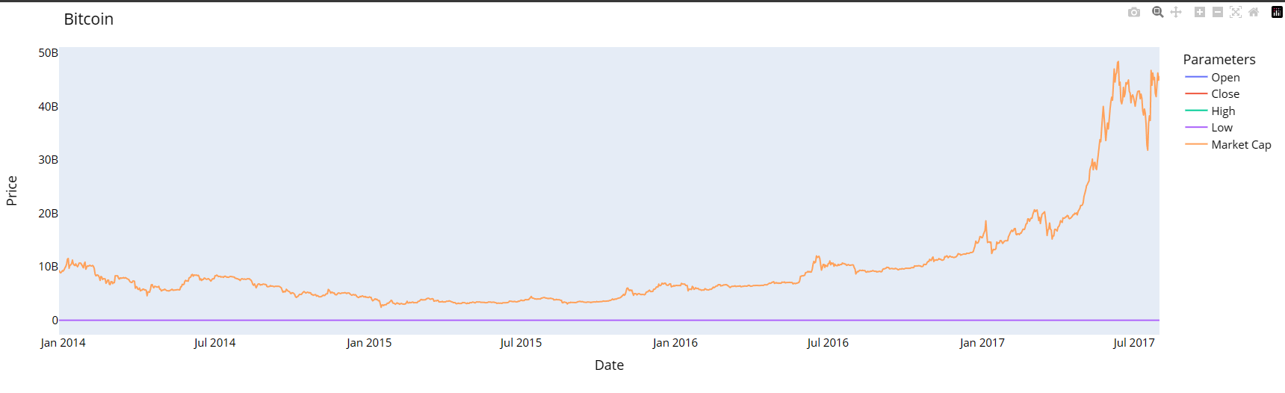
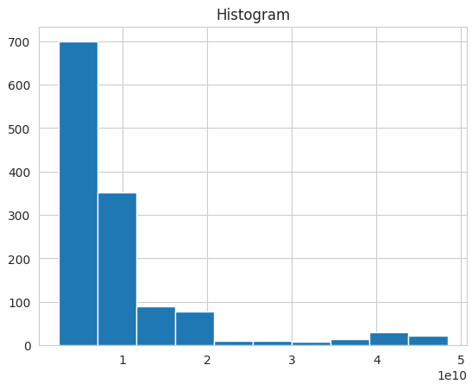
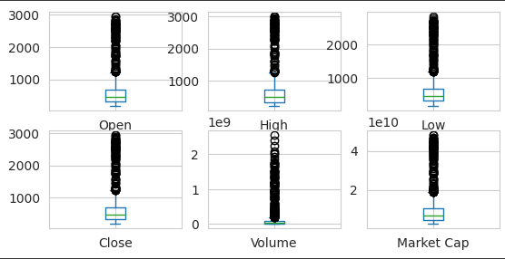
Result
VISUALIZE_BITCOIN
Box Pots

Slide 11
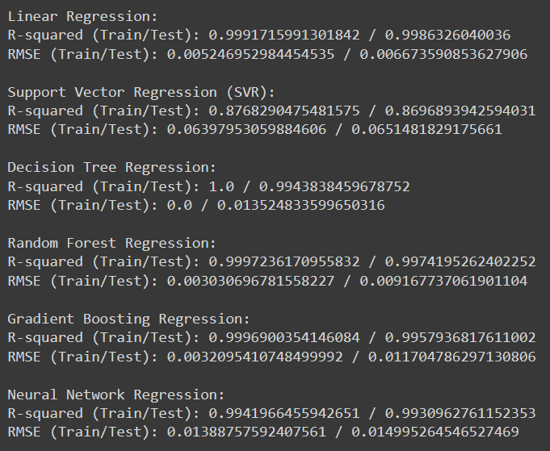
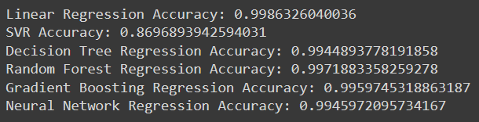
Result
Performance metrics – Model Accuracy, R-squared, RMSE

Slide 12
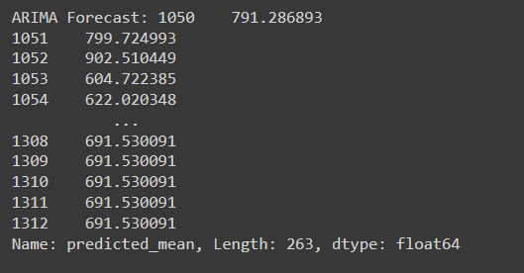
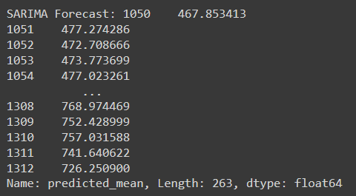
Result
Time Series Analysis

Slide 13
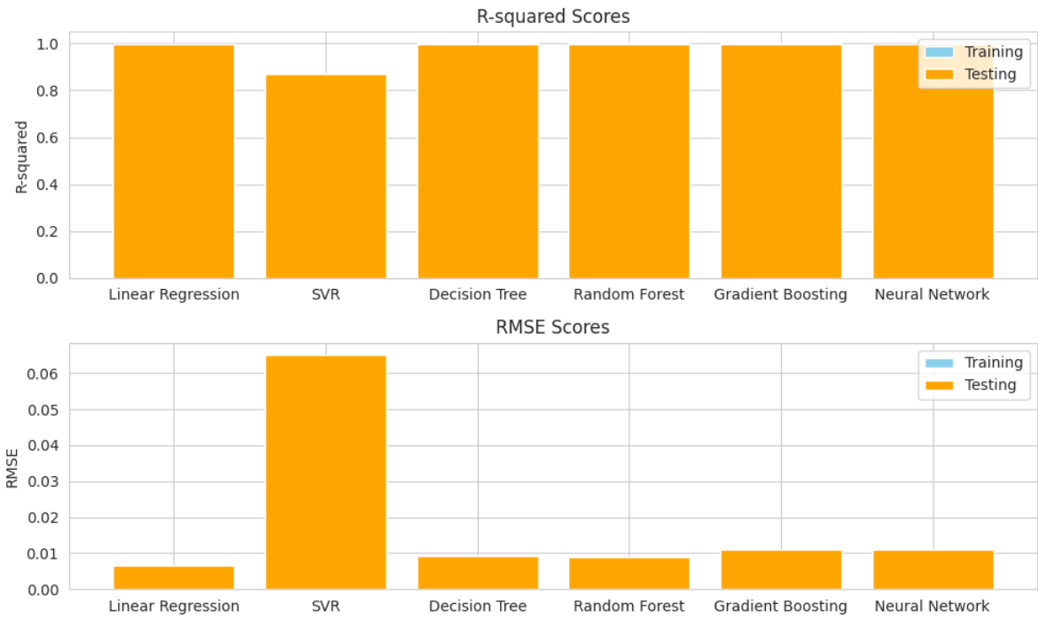
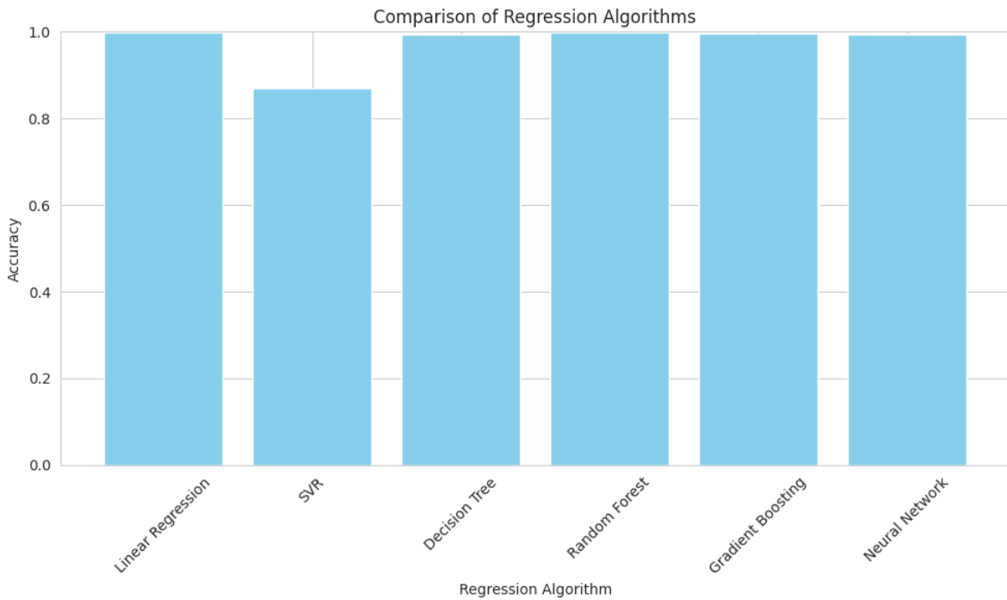
Result
Performance metrics – Model Accuracy, R-squared, RMSE

Slide 14
Conclusion
In conclusion, leveraging advanced machine learning algorithms such as Gradient Boosting Regression, Neural Network Regression for Bitcoin price prediction offers valuable insights into the highly volatile cryptocurrency market. By analyzing historical price data, trading volumes, sentiment analysis from various sources, and macroeconomic indicators, the model can generate accurate forecasts, aiding investors in making informed decisions. However, it's essential to continuously update and refine the model with real-time data inputs to adapt to evolving market conditions and improve prediction accuracy. Overall, the utilization of sophisticated algorithms in Bitcoin price prediction contributes to better risk management and enhanced investment strategies in the cryptocurrency space.

Slide 15
Future scope
Future scope for enhancing the Bitcoin price prediction system:
Incorporate Additional Data Sources:
Utilize blockchain metrics, social media sentiment analysis, and geopolitical events data.
Integrate data from cryptocurrency derivatives markets for comprehensive analysis.
Algorithm Optimization:
Explore deep learning architectures like networks and ensemble learning methods.
Implement advanced feature engineering techniques to improve model performance.
Geographic Expansion:
Extend the system to cover multiple cryptocurrency exchanges and regions.
Customize models for specific geographic regions or market segments.
Integration of Emerging Technologies:
Implement edge computing for real-time data processing.
Explore federated learning for collaborative model training and blockchain for enhanced data transparency and security.

Slide 16
References
[1] Z. Chen, C. Li, and W. Sun, "Bitcoin price prediction using machine learning: An approach to sample dimension engineering," Journal of Computational and Applied Mathematics, vol. 365, p. 112395, 2020, ISSN 0377-0427, doi: 10.1016/j.cam.2019.112395.
[2] Ji, Suhwan, Jongmin Kim, and Hyeonseung Im. 2019. "A Comparative Study of Bitcoin Price Prediction Using Deep Learning" Mathematics 7, no. 10: 898. https://doi.org/10.3390/math7100898
[3] T. Phaladisailoed and T. Numnonda, "Machine Learning Models Comparison for Bitcoin Price Prediction," 2018 10th International Conference on Information Technology and Electrical Engineering (ICITEE), Bali, Indonesia, 2018, pp. 506-511, doi: 10.1109/ICITEED.2018.8534911. [4] A. Azari, "Bitcoin Price Prediction: An ARIMA Approach," CoRR, vol. abs/1904.05315, 2019. http://arxiv.org/abs/1904.05315
[5] E. Sin and L. Wang, "Bitcoin price prediction using ensembles of neural networks," 2017 13th International Conference on Natural Computation, Fuzzy Systems and Knowledge Discovery (ICNC-FSKD), Guilin, China, 2017, pp. 666-671, doi: 10.1109/FSKD.2017.8393351.
[6] A. M. Khedr, I. Arif, P. R. P. V., M. El-Bannany, S. M. Alhashmi, and M. Sreedharan, "Cryptocurrency price prediction using traditional statistical and machine-learning techniques: A survey," Intelligent Systems in Accounting, Finance & Management, 23-Mar-2021. https://doi.org/10.1002/isaf.1488

Slide 17

course certificate 1

Slide 18

course certificate 2

Slide 19
THANK YOU

